Slide 1
Retaining Water Ice in Regolith at Vacuum - T519
VDR 2
November 14, 2023

Slide 2
Team Introductions
Katherine Mesa
Kevin Hernandez Lichtl
Astronautical Engineer
Luke Leibkuchler
Systems Engineer
Katherine Mesa
Fluid Test Engineer
Megan Reid
Design Engineer
Trent Walker
Thermal Fluids Engineer

Slide 3
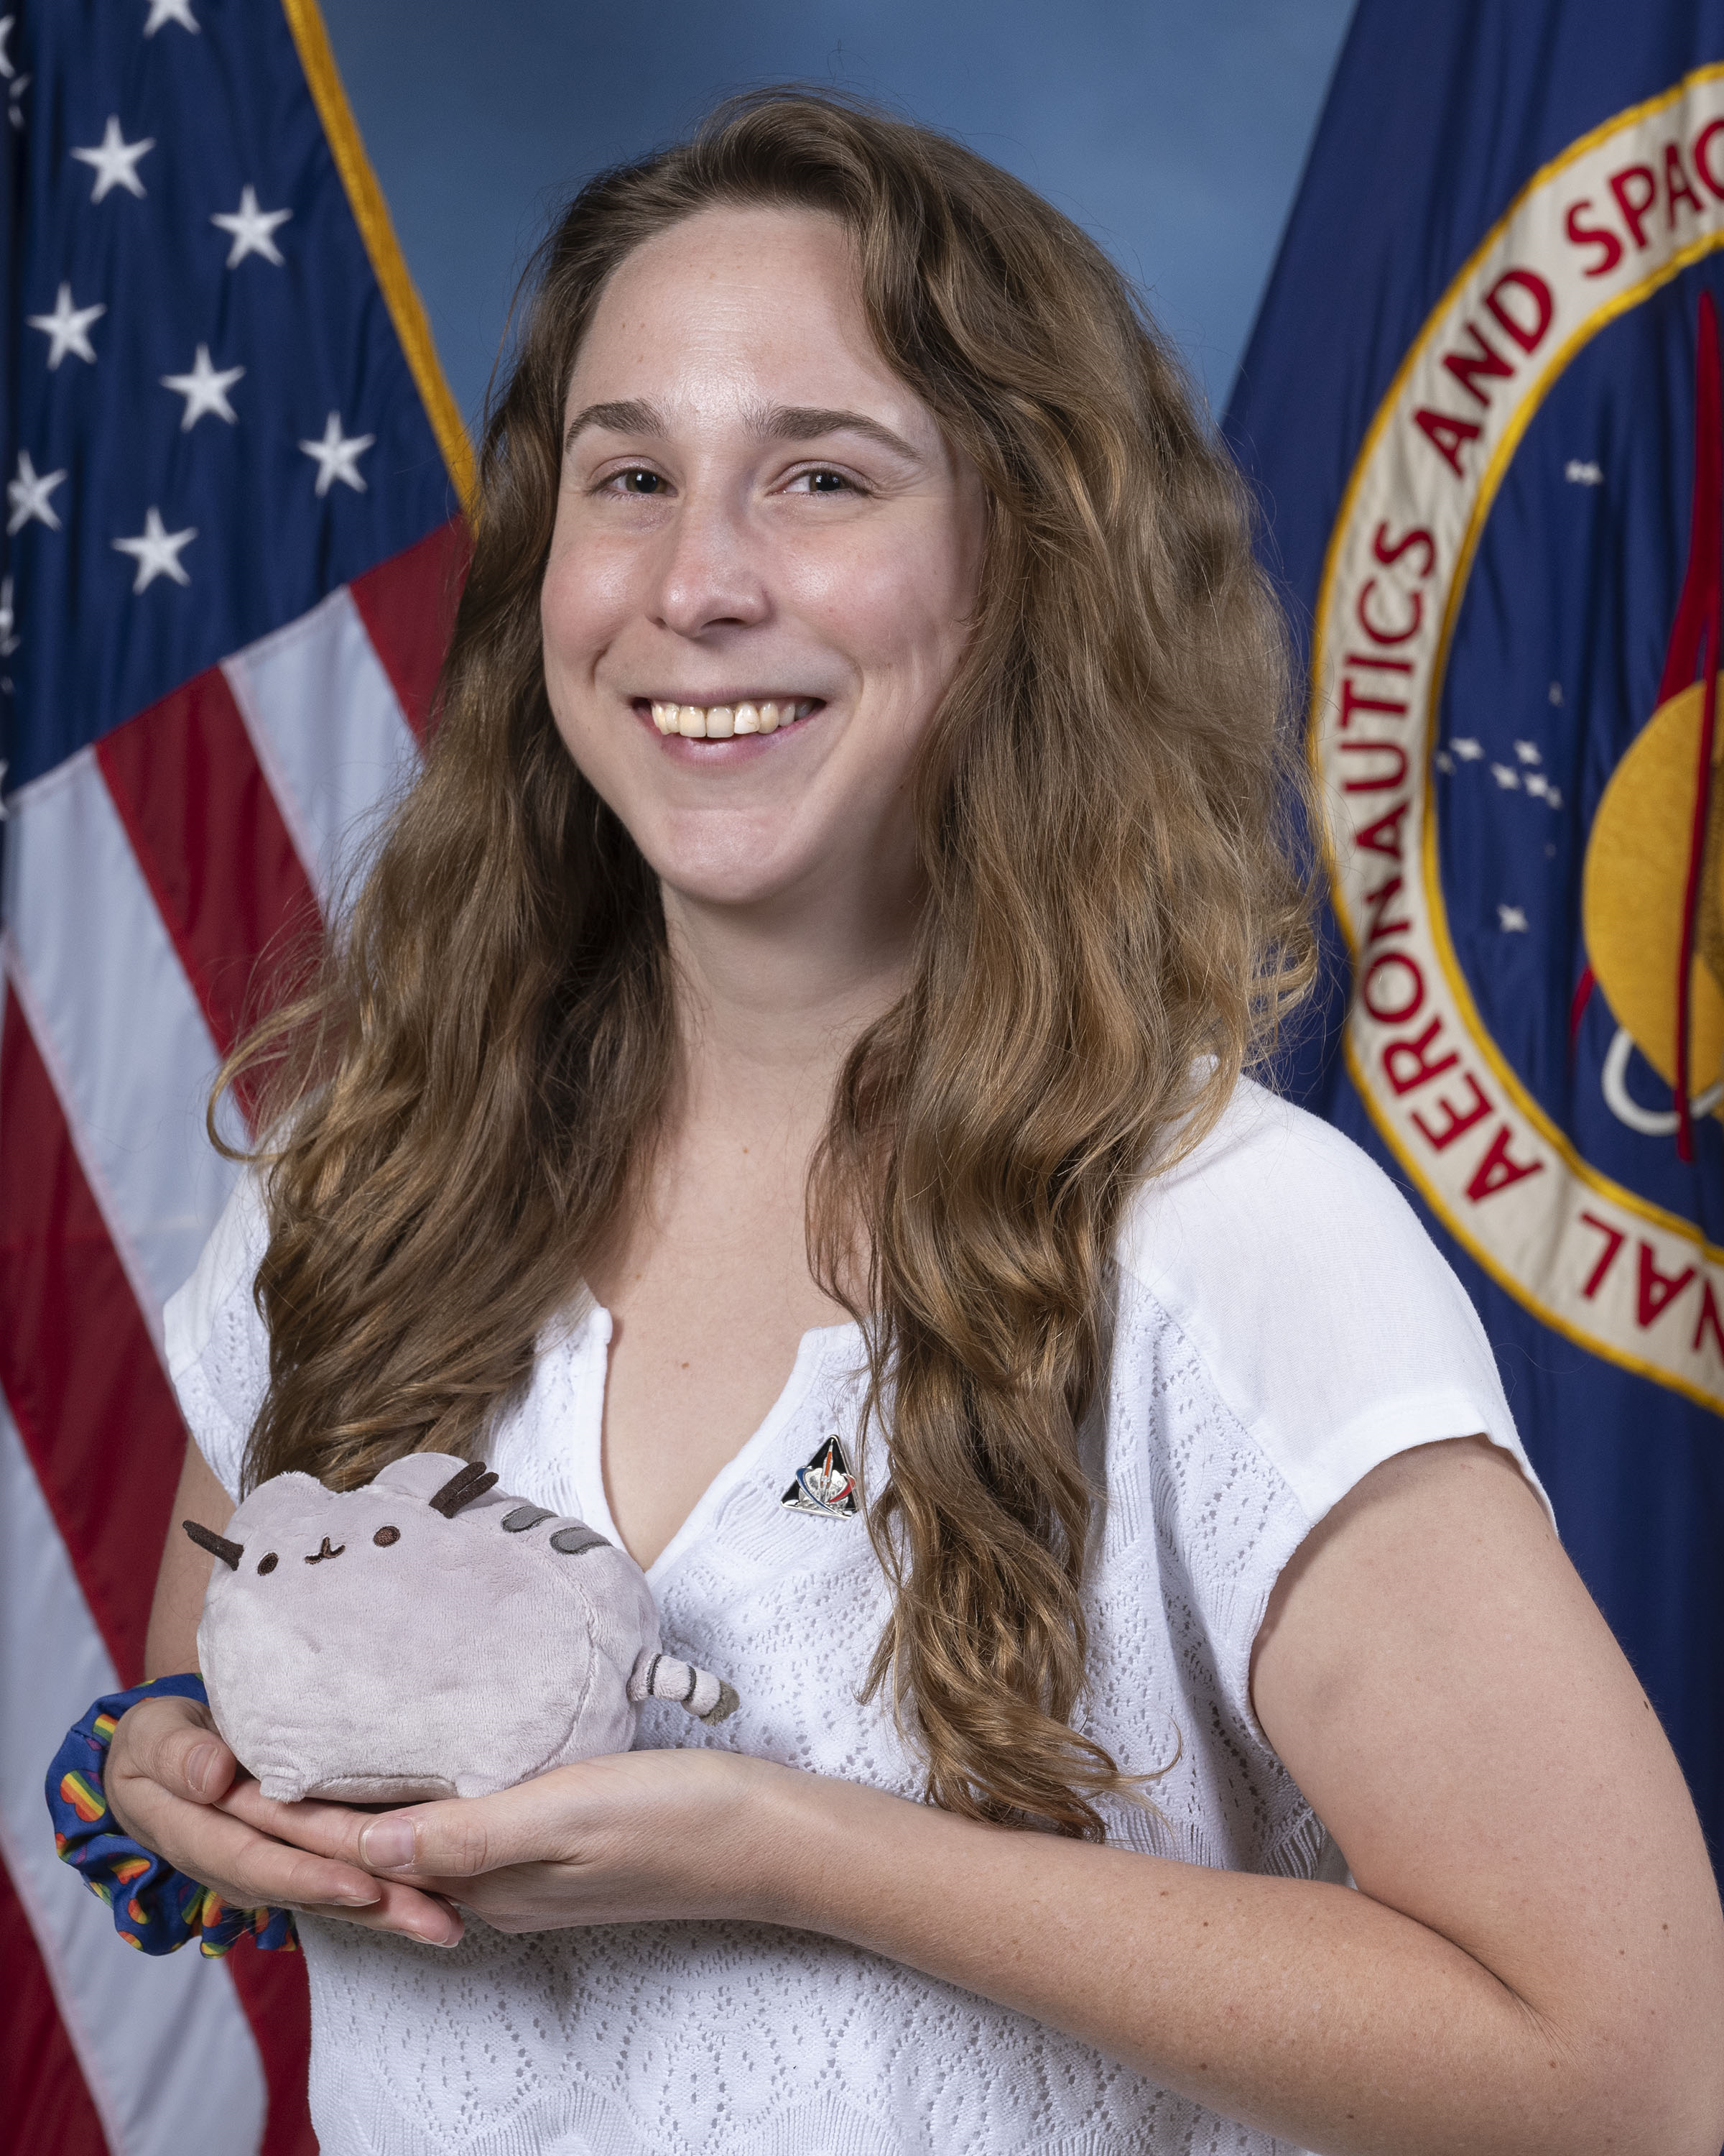
Sponsor and Advisor
Katherine Mesa
Annette Gray
NASA-Marshall Space Flight Center
Mentor
Marvin Barnes
NASA-Marshall Space Flight Center
Sponsor
Dr. Shayne McConomy
FAMU-FSU College of Engineering
Advisor

Slide 4
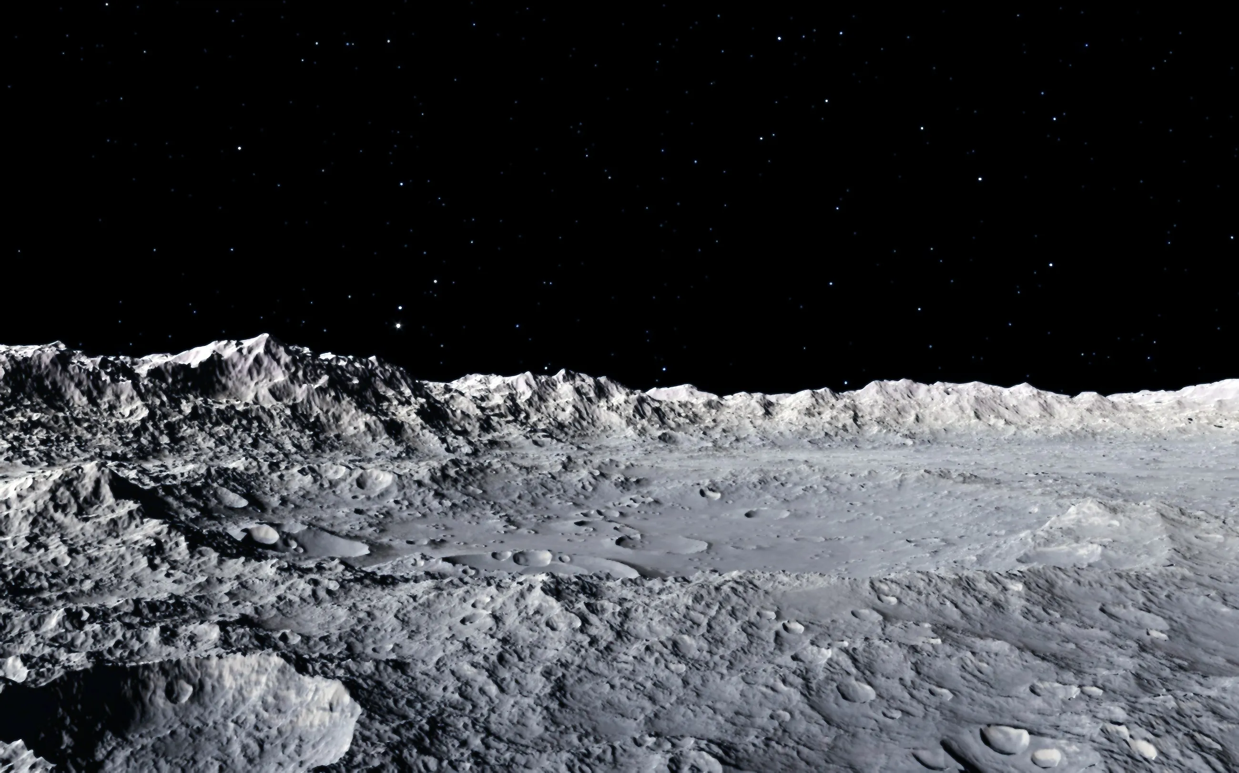
Objective
Katherine Mesa
Develop a solution to maintain water ice in regolith at high vacuum pressure

Slide 5
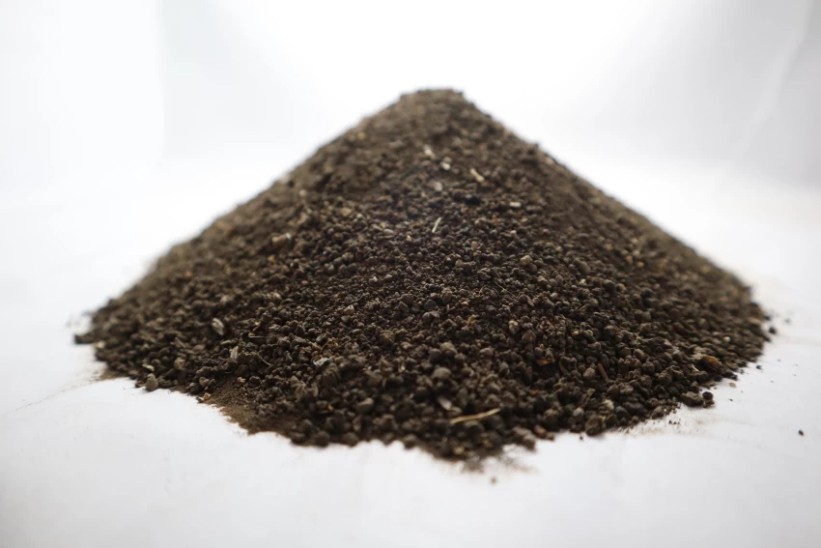
Background
Katherine Mesa
Regolith is the layer of rock and dust on the moon
Highly insulative
Notes:
Made of rock chips, mineral fragments, impact and volcanic glasses and a Moon component called “agglutinates”

Slide 6
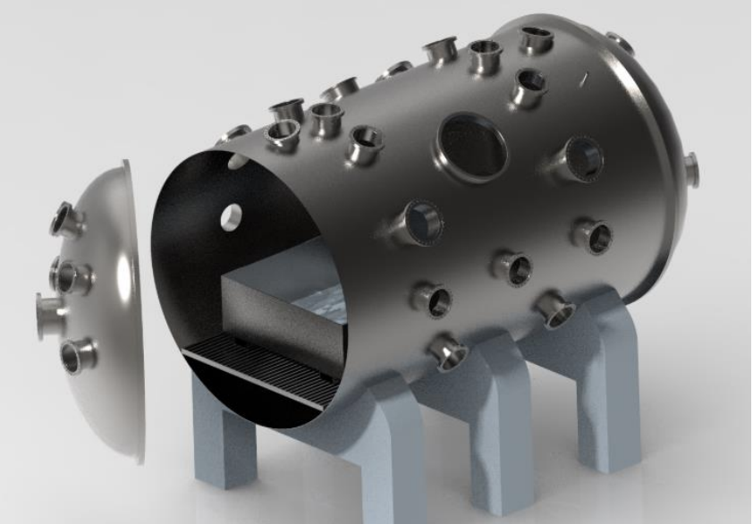
Background
Katherine Mesa
Regolith is the layer of rock and dust on the moon
Highly insulative
PLANET Chamber
High-fidelity lunar surface environment inside a high-vacuum chamber at NASA
Notes:
Made of rock chips, mineral fragments, impact and volcanic glasses and a Moon component called “agglutinates”

Slide 7
Customer Needs
Katherine Mesa
Water
Phase
Uniform
Properties
Monitor
Properties
PLANET
Chamber
Pressure
Maintain water in the solid phase
Water will be in the regolith

Slide 8
Customer Needs
Katherine Mesa
Water
Phase
Uniform
Properties
Monitor
Properties
PLANET
Chamber
Pressure
Maintain water in the solid phase
Water will be in the regolith
Operates in atmospheric to high vacuum pressure
Mimics space environment

Slide 9
Customer Needs
Katherine Mesa
Water
Phase
Uniform
Properties
Monitor
Properties
PLANET
Chamber
Pressure
Maintain water in the solid phase
Water will be in the regolith
Operates in atmospheric to high vacuum pressure
Mimics space environment
Reaches desired moisture, pressure, and temperature in regolith

Slide 10
Customer Needs
Katherine Mesa
Water
Phase
Uniform
Properties
Monitor
Properties
PLANET
Chamber
Pressure
Maintain water in the solid phase
Water will be in the regolith
Operates in atmospheric to high vacuum pressure
Mimics space environment
Reaches desired moisture, pressure, and temperature in regolith
Ability to monitor moisture, pressure, and temperature in regolith

Slide 11
Customer Needs
Katherine Mesa
Water
Phase
Uniform
Properties
Monitor
Properties
PLANET
Chamber
Pressure
Maintain water in the solid phase
Water will be in the regolith
Operates in atmospheric to high vacuum pressure
Mimics space environment
Reaches desired moisture, pressure, and temperature in regolith
Ability to monitor moisture, pressure, and temperature in regolith
Fits into and is compatible with the PLANET Chamber

Slide 12
Functional Decomposition
Katherine Mesa
NASA Cooling Fixture
Thermal
Controls
Structure

Slide 13
Critical Functions
Katherine Mesa
NASA Cooling Fixture
Thermal
Controls
Structure
Pre Pump Down
Post Pump Down
Control Water Composition
Cool Entire Mass to Cryogenic Temperatures
Pump to High Vacuum

Slide 14
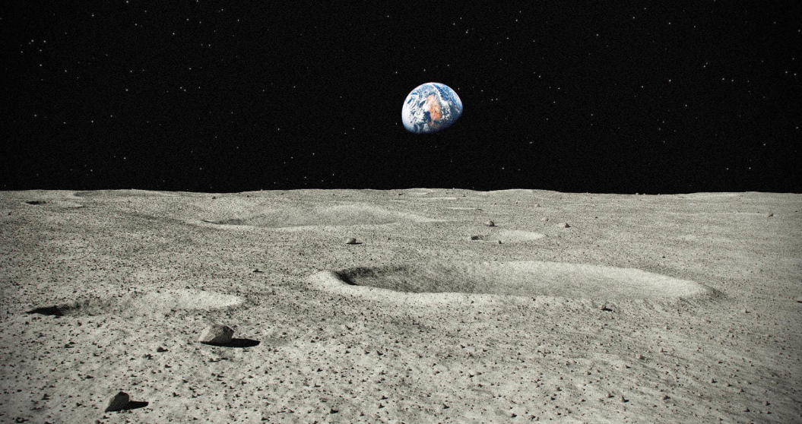
Targets and Metrics
Trent Walker

Slide 15
Targets and Metrics
Trent Walker
4-10%

Slide 16
Targets and Metrics
Trent Walker
4-10%
173.15 K - 203.15 K

Slide 17
Targets and Metrics
Trent Walker
4-10%
1.33e-4 Pa – 1.33e-5 Pa
173.15 K - 203.15 K

Slide 18
Concept Generation
Trent Walker
100 Concepts
3 High Fidelity
5 Medium Fidelity

Slide 19
Medium Fidelity
Trent Walker
Liquid Nitrogen Fins
Retractable Cooling Coils
Liquid Nitrogen Regolith Soak
1
2
3
4
5
Vacuum Isolation Jacket
Cooling Plate Base

Slide 20
Medium Fidelity
Trent Walker
1
2
3
4
5
Liquid Nitrogen Fins
Fins with LN2 running through regolith every square inch of base length

Slide 21
Medium Fidelity
Trent Walker
1
2
3
4
5
Liquid Nitrogen Fins
Fins with LN2 running through regolith every square inch of base length
Vacuum Isolation Jacket
Flood box with cryogenic liquid to drop temperature which freezes water out of air, then add to dry regolith before pumping down to vacuum

Slide 22
Medium Fidelity
Trent Walker
1
2
3
4
5
Liquid Nitrogen Fins
Fins with LN2 running through regolith every square inch of base length
Vacuum Isolation Jacket
Flood box with cryogenic liquid to drop temperature which freezes water out of air, then add to dry regolith before pumping down to vacuum
Retractable Cooling Coils
Cooling coils are layered throughout the length of the box/cylinder to evenly cool the entire regolith sample, coils are retractable

Slide 23
Medium Fidelity
Trent Walker
1
2
3
4
5
Liquid Nitrogen Fins
Fins with LN2 running through regolith every square inch of base length
Vacuum Isolation Jacket
Flood box with cryogenic liquid to drop temperature which freezes water out of air, then add to dry regolith before pumping down to vacuum
Retractable Cooling Coils
Cooling coils are layered throughout the length of the box/cylinder to evenly cool the entire regolith sample, coils are retractable
Cooling Plate Base
Sample box placed on top of 1D LN2 cooling plate, surrounded by vacuum isolation jacket

Slide 24
Medium Fidelity
Trent Walker
1
2
3
4
5
Liquid Nitrogen Fins
Fins with LN2 running through regolith every square inch of base length
Vacuum Isolation Jacket
Flood box with cryogenic liquid to drop temperature which freezes water out of air, then add to dry regolith before pumping down to vacuum
Retractable Cooling Coils
Cooling coils are layered throughout the length of the box/cylinder to evenly cool the entire regolith sample, coils are retractable
Cooling Plate Base
Sample box placed on top of 1D LN2 cooling plate, surrounded by vacuum isolation jacket
Liquid Nitrogen Regolith Soak
Sample placed in cold box and soaked with liquid nitrogen

Slide 25
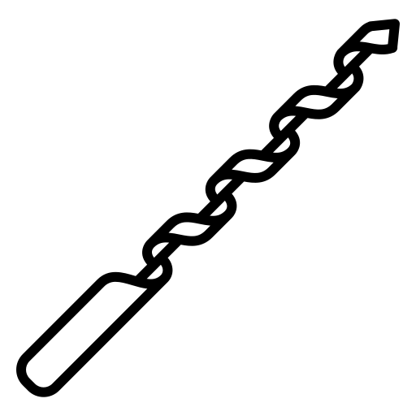
High Fidelity
Kevin Hernandez Lichtl
Cryogenic Jacket
Retractable Augers
1
2
3
Liquid Nitrogen Drip

Slide 26
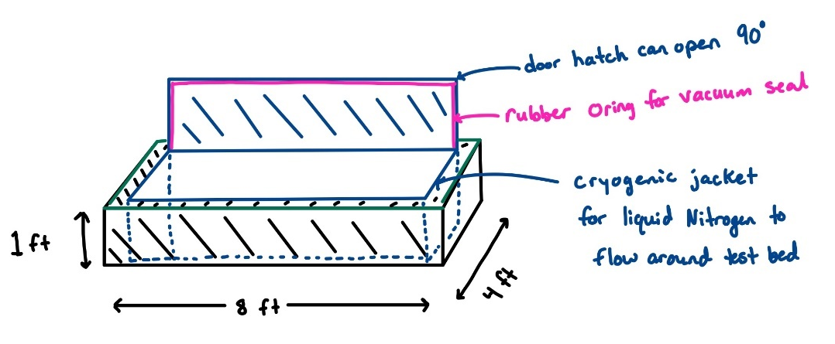
Cryogenic Jacket and Mixer
Kevin Hernandez Lichtl
1
2
3

Slide 27
Liquid Nitrogen Drip
Kevin Hernandez Lichtl
LN2 Liquid
Regolith Bed
1
2
3

Slide 28
Liquid Nitrogen Drip
Kevin Hernandez Lichtl
LN2 Liquid
LN2 Liquid Drip
Regolith Bed
1
2
3

Slide 29
Liquid Nitrogen Drip
Kevin Hernandez Lichtl
LN2 Liquid
LN2 Liquid Drip
LN2 Gas Exit
Pump
Regolith Bed
1
2
3

Slide 30
Liquid Nitrogen Drip
Kevin Hernandez Lichtl
LN2 Liquid
LN2 Liquid Drip
LN2 Gas Exit
Pump
Regolith Bed
Bottom Grate
LN2 Gas Reentry
1
2
3

Slide 31
Liquid Nitrogen Drip
Kevin Hernandez Lichtl
LN2 Liquid
LN2 Liquid Drip
LN2 Gas Exit
Pump
Regolith Bed
LN2 Gas Exit
Bottom Grate
LN2 Gas Reentry
1
2
3

Slide 32
Retractable Augers
Kevin Hernandez Lichtl
1
2
3

Slide 33
Retractable Augers
Kevin Hernandez Lichtl
1
2
3

Slide 34
Retractable Augers
Kevin Hernandez Lichtl
1
2
3

Slide 35
Retractable Augers
Kevin Hernandez Lichtl
1
2
3

Slide 36
Retractable Augers
Kevin Hernandez Lichtl
1
2
3

Slide 37
Retractable Augers
Kevin Hernandez Lichtl
1
2
3

Slide 38
Concept Selection House of Quality
Trent Walker
Ability to Cool
Ability to Add Water
Valve Connection
Maneuverability
Sensor Placement

Slide 39
Concept Selection Pugh Chart: 1st Iteration
Trent Walker
Liquid
Nitrogen Drip
Vacuum
Isolation Jacket
Retractable Augers
Liquid Nitrogen Regolith Soak
Cooling Plate Base
Retractable
Cooling Coils
Liquid Nitrogen Fins
Cryogenic Jacket

Slide 40
Concept Selection Pugh Chart: 2nd Iteration
Trent Walker
Liquid
Nitrogen Drip
Vacuum
Isolation Jacket
Retractable Augers
Retractable
Cooling Coils
Cryogenic Jacket

Slide 41
Concept Selection Pugh Chart: Final Iteration
Trent Walker
Liquid
Nitrogen Drip
Retractable Augers
Cryogenic Jacket

Slide 42
Concept Selection Analytical Hierarchy Process
Trent Walker

Slide 43
Final Selection
Kevin Hernandez Lichtl
Liquid
Nitrogen Drip
Can Cool Entire Bed Evenly
Ease of Controlling Water Composition
Minimal Impact to PLANET
Operates in High Vacuum Pressure

Slide 44
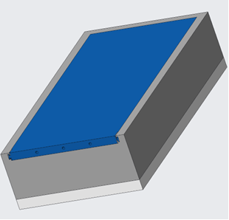
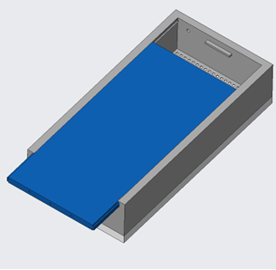
Preliminary Drip Lid CAD
Kevin Hernandez Lichtl
Top View - Closed
Top View - Open

Slide 45
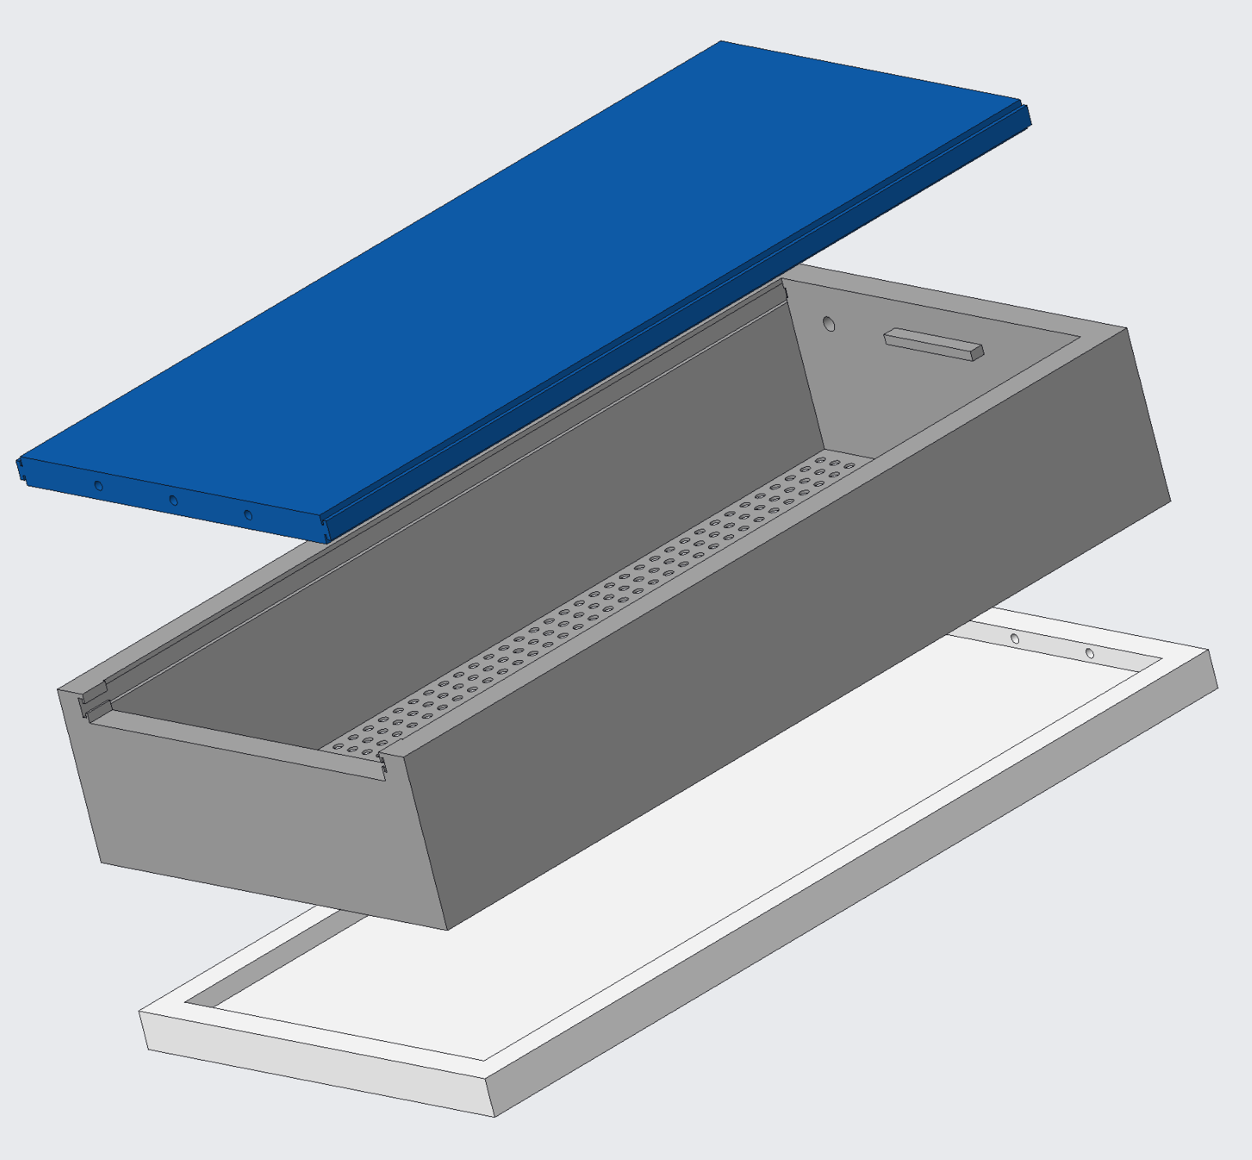
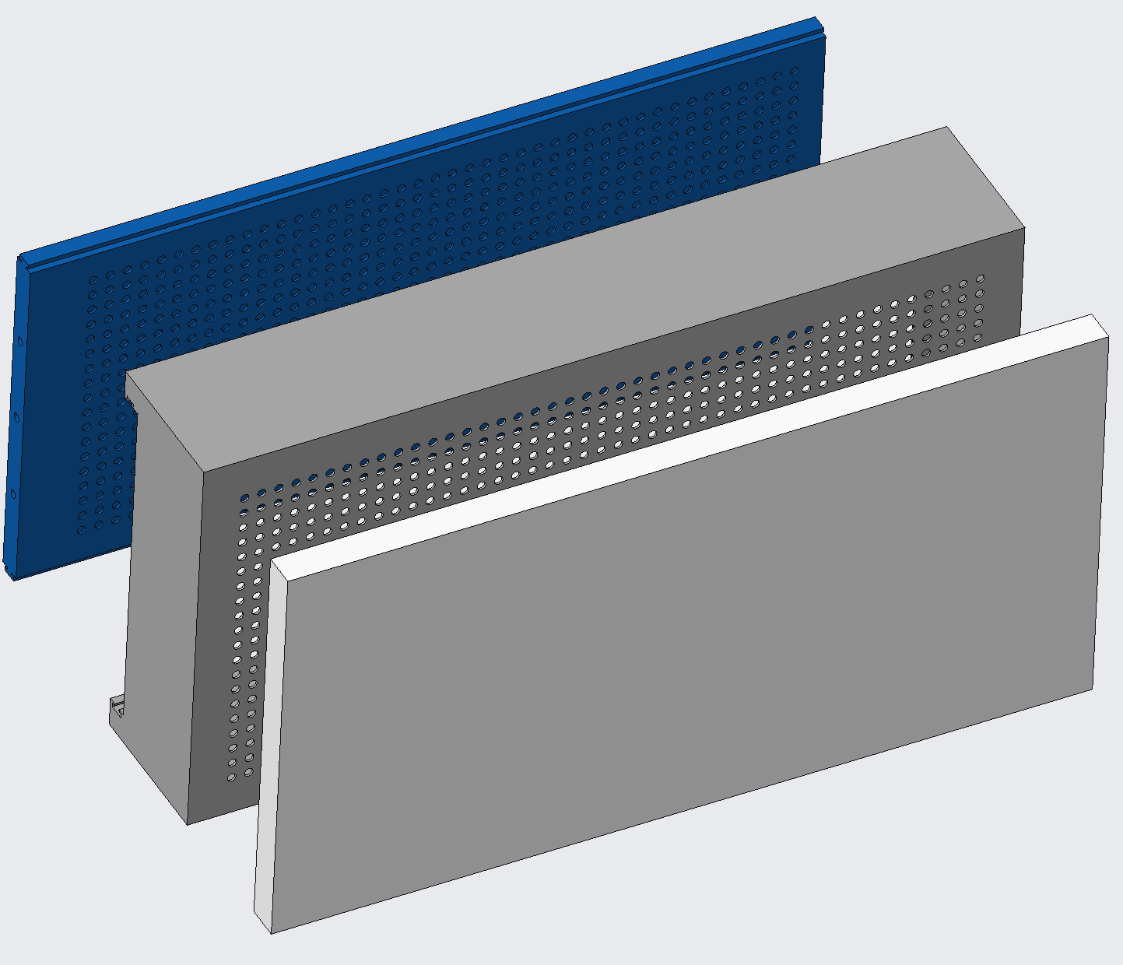
Preliminary Drip Lid CAD
Kevin Hernandez Lichtl
Side View - Exploded
Bottom View - Exploded

Slide 46
Future Work
Kevin Hernandez Lichtl
Prototype Design
Prototype Fabrication
Bill of
Materials
Design an initial prototype
Fabricate initial prototype
Create bill of materials
Meeting with MagLab personnel regarding vacuum chambers
Perform risk assessment
Order materials for final design
MagLab Meeting
Risk
Assessment
Order Materials
Meet with advising team
Notes:
Targets and Metrics
Concept Generation and Selection
Prototypes
Biweekly Sponsor Meetings
Risk Assessment
Bill of Materials
Spring Project Plan

Slide 47
Thank You!
Notes:
Targets and Metrics
Concept Generation and Selection
Prototypes
Biweekly Sponsor Meetings
Risk Assessment
Bill of Materials
Spring Project Plan

Slide 48
Backup Slides

Slide 49
Backup Slides

Slide 50
Backup Slides

Slide 51
Stake holders
Notes:
NASA
National High Magnetic Field Lab (Maglab)
Dr. McConomy

Slide 52
PLANET Chamber Planetary, Lunar, and Asteroid Natural Environments Testbed
Megan Reid
A high-fidelity lunar surface environment inside a well equipped high-vacuum chamber at NASA’s Marshall Space Flight Center

Slide 53
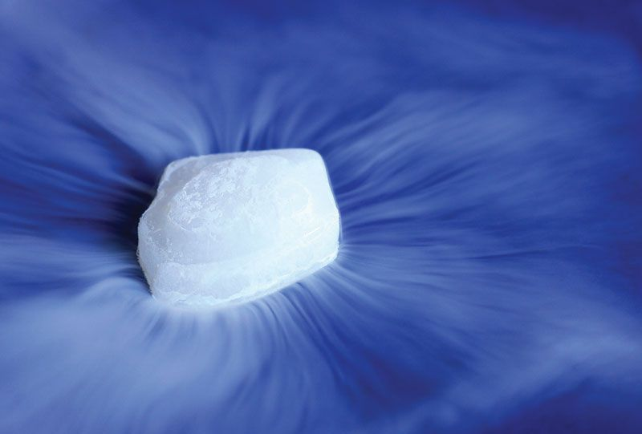
Current Issue
Megan Reid
Water ice in regolith will sublimate to gas if not cold enough before high vacuum
Water vapor condenses out of air when cooled before vacuum
Notes:
Water VAPOR, condenses out of air when cooled before vacuum...
affecting regolith-water content

Slide 54
Megan Reid
Key Goals
Thermal Maintenance
Regolith
PLANET
Chamber
High Vacuum
Notes:
Cool regolith simulant bed before and during high vacuum (10^-7 Torr)
Regolith needs to be cooled to a low enough temperature before depressurization so that water ice doesn’t sublimate
Needs to fit within the NASA PLANET Chamber

Slide 55
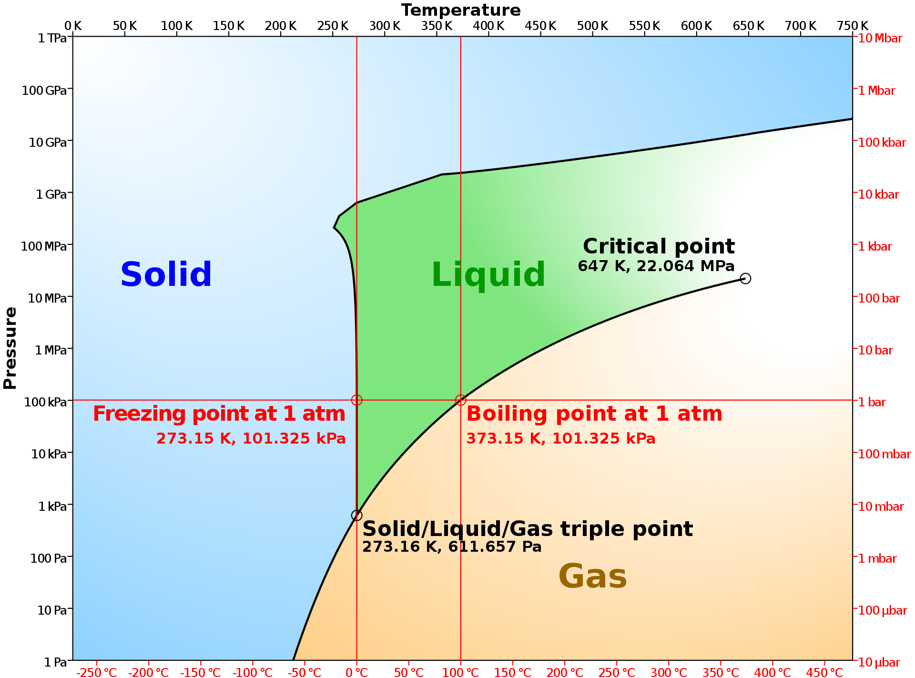
Properties of Water
Megan Reid

Slide 56
Customer Needs
Luke Leibkuchler
Maintain Water at Ice in Regolith
Operate in Atmospheric to High Vacuum Pressure
Uniform Moisture, Pressure, and Temperature in Regolith
Ability to Monitor Properties
Operate in PLANET Chamber

Slide 57
Customer Needs
Luke Leibkuchler
Maintain Water at Ice in Regolith
Operate in Atmospheric to High Vacuum Pressure
Uniform Moisture, Pressure, and Temperature in Regolith
Ability to Monitor Properties
Operate in PLANET Chamber

Slide 58
Customer Needs
Luke Leibkuchler
Maintain Water at Ice in Regolith
Operate in Atmospheric to High Vacuum Pressure
Uniform Moisture, Pressure, and Temperature in Regolith
Ability to Monitor Properties
Operate in PLANET Chamber

Slide 59
Customer Needs
Luke Leibkuchler
Maintain Water at Ice in Regolith
Operate in Atmospheric to High Vacuum Pressure
Uniform Moisture, Pressure, and Temperature in Regolith
Ability to Monitor Properties
Operate in PLANET Chamber

Slide 60
Customer Needs
Luke Leibkuchler
Maintain Water at Ice in Regolith
Operate in Atmospheric to High Vacuum Pressure
Uniform Moisture, Pressure, and Temperature in Regolith
Ability to Monitor Properties
Operate in PLANET Chamber

Slide 61
Customer Needs
Luke Leibkuchler
Maintain Water at Ice in Regolith
Operate in Atmospheric to High Vacuum Pressure
Uniform Moisture, Pressure, and Temperature in Regolith
Ability to Monitor Properties
Operate in PLANET Chamber

Slide 62
Markets & Stakeholders
Megan Reid
NASA
MagLab
Private Aerospace Companies
FAMU-FSU
Notes:
Primary:
NASA
Secondary:
SpaceX, Boeing, or Blue Origin
Private aerospace companies developing extraction and excavation technologies

Slide 63
Customer Needs
Maintain Water at Ice
Operate in Atmospheric to High Vacuum Pressure
Uniform Moisture, Pressure, and Temperature in Regolith
Ability to Monitor Properties
Operate in PLANET Chamber

Slide 64
Functional Decomposition
Luke Leibkuchler
NASA Regolith Cooling Fixture
Thermal
Structure
Controls

Slide 65
Functional Decomposition
Luke Leibkuchler
NASA Regolith Cooling Fixture
Thermal
Structure
Controls

Slide 66
Functional Decomposition
Luke Leibkuchler
Thermal
Pre Pump Down
Post Pump Down
Water in Air
Cool Entire Mass to Cryogenic Temperatures
High Vacuum

Slide 67
Functional Decomposition
Luke Leibkuchler
NASA Regolith Cooling Fixture
Thermal
Structure
Controls

Slide 68
Functional Decomposition
Luke Leibkuchler
Controls
User Interface
Motion
Data Acquisition
Display
Hatch

Slide 69
Functional Decomposition
Luke Leibkuchler
NASA Regolith Cooling Fixture
Thermal
Structure
Controls

Slide 70
Functional Decomposition
Luke Leibkuchler
Structure
Operate within PLANET
Withstand PLANET
In and Out of Chamber
Within Dimensions
Electrical Components
Integrity at Extreme Conditions

Slide 71
Functional Decomposition
Thermal
Pre-Pump Down
Post-Pump Down
Prevent water condensation
Cool entire regolith mass to –180 degC
Maintain high vacuum pressure within the fixture
Maintain specific regolith-water composition

Slide 72
Functional Decomposition
Structure
Operate within PLANET chamber
Withstand PLANET conditions
Protect electrical/
mechanical components
Maintain structural integrity
Allows transport in and out of chamber
Fit within chamber dimensions
Withstands cryogenic temperatures
Withstands high vacuum
Utilizes materials invisible to microwave radiation
Allows flow of coolant

Slide 73
Functional Decomposition
Controls
Motion
User Interface
DAQ
Display
Open hatch for testing
Close hatch after testing
Collect water moisture and fixture pressure data
Collect
temperature data
Display water moisture and fixture pressure data
Display hatch position data
Collect hatch position data
Collect coolant flow rate data
Display temperature data
Display coolant flow rate data

Slide 74
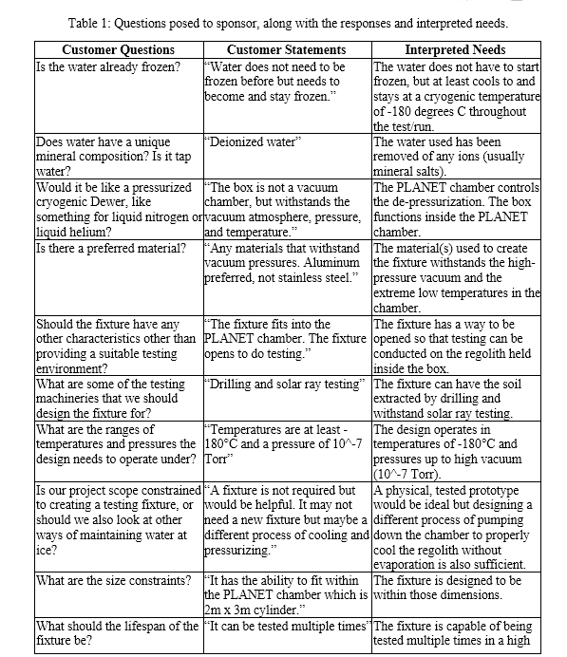
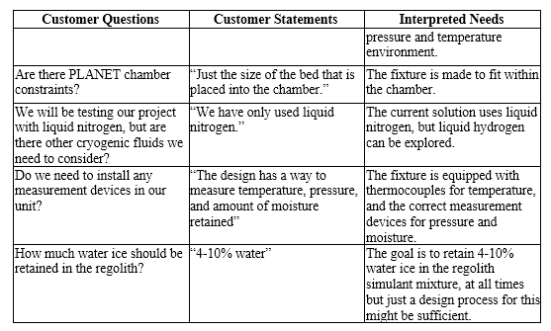
Customer Needs

Slide 75
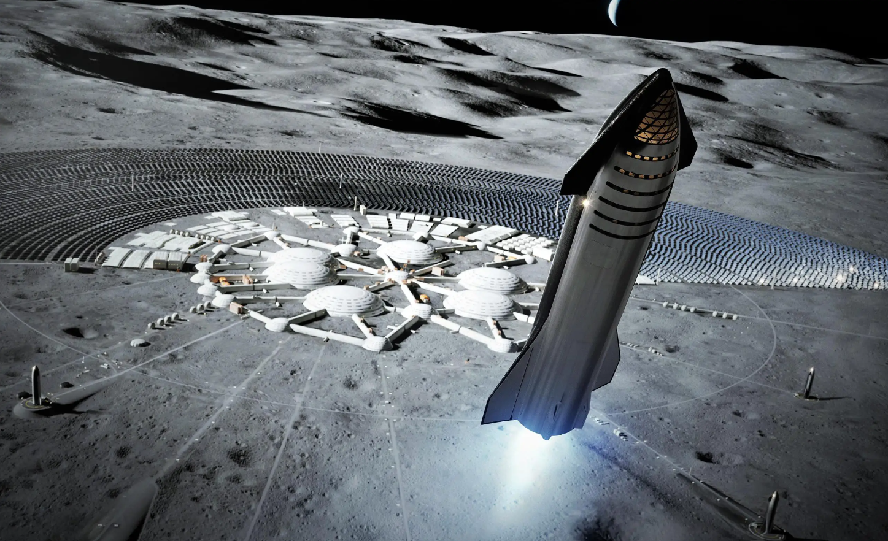
Space Exploration
Megan Reid
To enable human travel throughout the solar system, a lunar colony will be a necessity
Lunar refueling station:
Lower gravity
Water ice in shadowed craters
Convert H₂O --> H₂ + O for spacecraft fuel
NASA is exploring technologies for extraction of lunar water ice from lunar regolith
Notes:
To allow for human travel throughout the solar system, it is believed a lunar colony will be a necessity.
Rather than embarking from Earth, a lunar station will significantly more energy efficient as the moon has a much weaker gravitational force to overcome.
It is believed the moon has water ice hidden in permanently shadowed areas of craters.
Convert H2O --> H2 + O

Slide 76
Properties of Water
Megan Reid
Notes:
Water Phase Diagram
Lots of energy when saying going down to this pressure without sublimating – main reason we are here

Slide 77
Properties of Water
Megan Reid
Notes:
Lots of energy when saying going down to this pressure without sublimating – main reason we are here

Slide 78
Properties of Water
Megan Reid
Notes:
Lots of energy when saying going down to this pressure without sublimating – main reason we are here

Slide 79
Properties of Water
Megan Reid
Notes:
Lots of energy when saying going down to this pressure without sublimating – main reason we are here

Slide 80
Properties of Water
Megan Reid
Notes:
Lots of energy when saying going down to this pressure without sublimating – main reason we are here

Slide 81
Megan Reid
Key Goals
Thermal Maintenance
Notes:
Cool regolith simulant bed before and during high vacuum (10^-7 Torr)
Regolith needs to be cooled to a low enough temperature before depressurization so that water ice doesn’t sublimate
Needs to fit within the NASA PLANET Chamber

Slide 82
Megan Reid
Key Goals
Thermal Maintenance
Regolith
Notes:
Cool regolith simulant bed before and during high vacuum (10^-7 Torr)
Regolith needs to be cooled to a low enough temperature before depressurization so that water ice doesn’t sublimate
Needs to fit within the NASA PLANET Chamber

Slide 83
Megan Reid
Key Goals
Thermal Maintenance
Regolith
PLANET
Chamber
Notes:
Cool regolith simulant bed before and during high vacuum (10^-7 Torr)
Regolith needs to be cooled to a low enough temperature before depressurization so that water ice doesn’t sublimate
Needs to fit within the NASA PLANET Chamber

Slide 84
Megan Reid
Key Goals
Thermal Maintenance
Regolith
PLANET
Chamber
High Vacuum
Notes:
Cool regolith simulant bed before and during high vacuum (10^-7 Torr)
Regolith needs to be cooled to a low enough temperature before depressurization so that water ice doesn’t sublimate
Needs to fit within the NASA PLANET Chamber

Slide 85
Megan Reid
Assumptions
Materials provided for final testing at NASA - MSFC
Operating Conditions
PLANET Chamber
Humidity is controlled at 65%
Instrumentation
Cooling with Cryogenic Liquids
Regolith Simulant
No extreme conditions
Notes:
Following Materials will supplied:
Liquid Nitrogen
Regolith Simulant
Vacuum Chamber
Instrumentation
Final testing conducted at Marshall Space Flight Center
Humidity is at 65% (controlled)

Slide 86
Markets & Stakeholders
Megan Reid
NASA - MSFC
SpaceX
Boeing
Blue Origin
Other Private Aerospace Companies
Notes:
Primary:
NASA
Secondary:
SpaceX, Boeing, or Blue Origin
Private aerospace companies developing extraction and excavation technologies

Slide 87
Customer Needs
Luke Leibkuchler
Water
Phase
Uniform
Properties
Monitor
Properties
PLANET
Chamber
Pressure
Maintain water in the solid phase
Water will be in the regolith

Slide 88
Customer Needs
Luke Leibkuchler
Water
Phase
Uniform
Properties
Monitor
Properties
PLANET
Chamber
Pressure
Maintain water in the solid phase
Water will be in the regolith
Operates in atmospheric to high vacuum pressure
Mimics space environment

Slide 89
Customer Needs
Luke Leibkuchler
Water
Phase
Uniform
Properties
Monitor
Properties
PLANET
Chamber
Pressure
Maintain water in the solid phase
Water will be in the regolith
Operates in atmospheric to high vacuum pressure
Mimics space environment
Reaches desired moisture, pressure, and temperature in regolith

Slide 90
Customer Needs
Luke Leibkuchler
Water
Phase
Uniform
Properties
Monitor
Properties
PLANET
Chamber
Pressure
Maintain water in the solid phase
Water will be in the regolith
Operates in atmospheric to high vacuum pressure
Mimics space environment
Reaches desired moisture, pressure, and temperature in regolith
Ability to monitor moisture, pressure, and temperature in regolith

Slide 91
Customer Needs
Luke Leibkuchler
Water
Phase
Uniform
Properties
Monitor
Properties
PLANET
Chamber
Pressure
Maintain water in the solid phase
Water will be in the regolith
Operates in atmospheric to high vacuum pressure
Mimics space environment
Reaches desired moisture, pressure, and temperature in regolith
Ability to monitor moisture, pressure, and temperature in regolith
Fits into and is compatible with the PLANET Chamber

Slide 92
Functional Decomposition
Luke Leibkuchler
NASA Cooling Fixture
Thermal
Controls
Structure

Slide 93
Functional Decomposition
Luke Leibkuchler
NASA Cooling Fixture
Thermal
Controls
Structure
Pre Pump Down
Post Pump Down
Control Water Composition
Cool Entire Mass to Cryogenic Temperatures
Pump to High Vacuum

Slide 94
Functional Decomposition
Luke Leibkuchler
NASA Cooling Fixture
Thermal
Controls
Structure
User Interface
Motion
Data Acquisition
Display Properties
Open Hatch

Slide 95
Functional Decomposition
Luke Leibkuchler
NASA Cooling Fixture
Thermal
Controls
Structure
Cool Entire Mass to Cryogenic Temperatures
User Interface
Motion
Data Acquisition
Display Properties
Open Hatch

Slide 96
Functional Decomposition
Luke Leibkuchler
NASA Cooling Fixture
Thermal
Controls
Structure
Withstand PLANET
Operate within PLANET
Protect Electrical Components
Structural Integrity at Extreme Conditions
Move In and Out of Chamber
Fit Within Dimensions

Slide 97
Functional Decomposition
Luke Leibkuchler
NASA Cooling Fixture
Thermal
Controls
Structure
Controls
Hatch
Withstand PLANET
Operate within PLANET
Protect Electrical Components
Structural Integrity at Extreme Conditions
Move In and Out of Chamber
Fit Within Dimensions

Slide 98
Future Work
Luke Leibkuchler
Target &
Metrics
Prototypes
Risk
Assessment
Create prototypes of high-fidelity concepts to aid in selection
Set targets and metrics for system
Perform risk assessment
Generate 100 ideas for solution that fits needs and targets
Select final concept
Create bill of materials
Concept
Generation
Concept
Selection
Bill of
Materials
Meet with advising team
Notes:
Targets and Metrics
Concept Generation and Selection
Prototypes
Biweekly Sponsor Meetings
Risk Assessment
Bill of Materials
Spring Project Plan

Slide 99
Preliminary Drip Lid CAD
Top View - Closed
Top View - Open

Slide 100
Preliminary Drip Lid CAD
Side View - Exploded
Bottom View - Exploded

Slide 101
Thank You!
Notes:
Targets and Metrics
Concept Generation and Selection
Prototypes
Biweekly Sponsor Meetings
Risk Assessment
Bill of Materials
Spring Project Plan

Slide 102
This is 10-point
This is 15–point Times
This is 20–point
This is 25–point
This is 30–point
This is 35–point
This is 40–point
This is 50–point
This is 60–point
This is 72–point
Notes:
Use at least 20-point font in Room A105, B134, and B136
Use at least 25-point font in Room B135

Slide 103
College of Engineering Color Palette
1 2 3 4
Pantone: PMS 195 C
RGB: 120, 47, 64
Hex: #782F40
CMYK:19, 90, 50, 55
1 2 3 4
Pantone: Black C
RGB: 0, 0, 0
Hex: #000000
CMYK:0, 0, 0, 100
Garnet
Black
1 2 3 4
RGB: 238, 118, 36
Hex: #EE7624
CMYK:2, 66, 99, 0
1 2 3 4
Pantone: PMS 000C
RGB: 255, 255, 255
Hex: #FFFFFF
CMYK: 0, 0, 0, 0
Fang
Orange
White
Notes:
Avoid 75% Black in B135

Slide 104
Accent Color Palette
1 2 3 4
RGB: 0, 59, 111
Hex: #003B6F
CMYK:
1 2 3 4
RGB: 0, 59, 111
Hex: #003B6F
CMYK:
1 2 3 4
RGB: 251, 236, 93
Hex: #FBEC5D
CMYK:
1 2 3 4
RGB: 219, 215, 210
Hex: #DBD7D2
CMYK:
1 2 3 4
RGB: 251, 236, 93
Hex: #FBEC5D
CMYK:
1 2 3 4
RGB: 219, 215, 210
Hex: #DBD7D2
CMYK:
Tardis Blue
Tardis Blue
Corn
Timberwolf
Corn
Timberwolf
1 2 3 4
RGB: 206, 0, 88
Hex: #CE0058
CMYK: 0, 100, 43, 12
1 2 3 4
RGB: 206, 0, 88
Hex: #CE0058
CMYK: 0, 100, 43, 12
1 2 3 4
RGB: 104, 40, 96
Hex: #682860
CMYK:
1 2 3 4
RGB: 220, 220, 220
Hex: #DCDCDC
CMYK:
Rubine Red
Rubine Red
Imperial
Gainsboro
1 2 3 4
RGB: 72, 146, 155
Hex: #48929b
CMYK:
1 2 3 4
RGB: 64, 224, 208
Hex: #40E0D0
CMYK:
1 2 3 4
RGB: 255, 139, 0
Hex: #FF8B00
CMYK:
Asagi-iro
Turquoise
American Orange
Notes:
Remove American orange add hyperlink grey
Make corn the last for b135
All work in 134 imperial move later
Tardis doesn’t work in b136

Slide 105
F7AB19
D67F15
EE7624
D64615
F73119
Analogous
https://color.adobe.com/create/color-wheel
6E3610
F0A16C
EE7624
6E4931
BASB1C
Monochromatic
A14508
4BED3B
EE7624
250CED
2010A1
Triad
A1470C
FF8C40
EE7624
0098A1
24E2ED
Complementary
28A164
2FED8D
EE7624
0848A1
1871ED
Split Complementary
EDAC2F
3BED93
EE7624
0C6AED
ED2F18
Double Split Complementary
ED660C
C7ED3B
EE7624
0CE1ED
A418ED
Square
BA7E09
87724A
EE7624
60EFCF
09BA61
Compound
AD551A
6E3610
EE7624
FA7625
D46820
Shades
Notes:
These are the variants that work well with Fang Orange. The bolded items show well on the projectors.

Slide 106
85412D
8F3831
782f40
8F3176
792D85
Analogous
https://color.adobe.com/create/color-wheel
C44D69
8E626D
782F40
C48796
451B25
Monochromatic
C43959
78743B
782F40
236178
43A2C4
Triad
C43959
C46078
782F40
25C43D
2F783A
Complementary
93C460
577835
782F40
39C49D
297861
Split Complementary
784435
5A783B
782F40
237860
6E2978
Double Split Complementary
782337
78683b
782F40
237830
293978
Square
AB4D32
DEBAAF
782F40
5D8555
70AB32
Compound
38161E
C44D69
782F40
853447
5E2532
Shades

Slide 107
A105
A105
B135 Stage Left
B135 Stage Right
B136
B134, A105
B135

